Slide 1
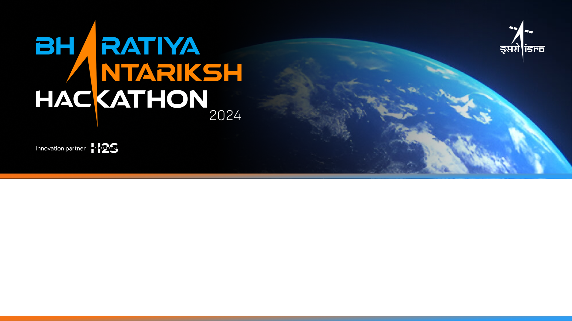
Team Name: Team Rollsroyce
Name of College(s)/University(s): St Joseph’s College of Engineering
Team Members Details:
Sam V George
Mohammad P
Pugazhendhi S
Kaviarasi K

Slide 2
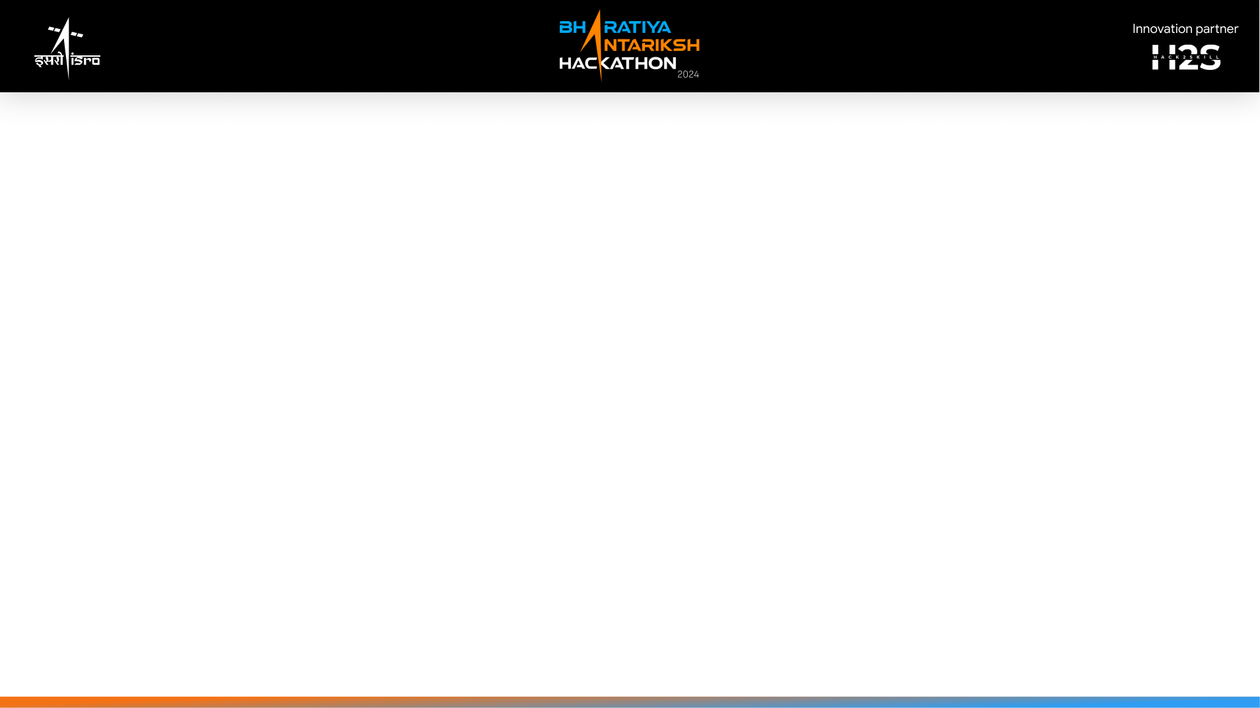
Detailed solution and Approach
Our project proposes advanced geospatial analysis and Deep Learning to detect and analyze lunar craters.
Using high-resolution OHRC images from Chandrayaan-2, we employ annotating / QGIS tools for georeferencing and annotation to enable accurate predictions.
This results in a more accurate and comprehensive analysis of lunar craters.

Slide 3
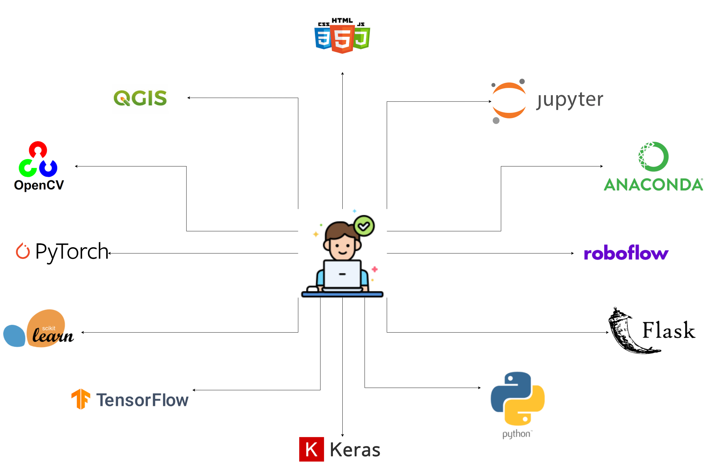
Tools and Technology Used
The Tools used for :
Data Preparation
QGIS and Roboflow annotator.
Modelling :
Programing language used is Python
Libraries used are Pytorch, Tensorflow, Keras, Numpy, Pandas, Open-CV .
Frontend(graphical user interface):
HTML
CSS
JavaScript
Flask(Python)

Slide 4
1.How different is it from any of the other existing ideas?
The existing methods solely address detecting the craters using DL strategies, which lack the ability to classify the various craters on the surface of the Moon
2.How will it be able to solve the problem?
The DL model will demonstrate strong transferability and generalization capabilities, allowing it to be applied effectively to detect small, medium and large craters on the celestial body of the Moon.
3.USP of the proposed solution
The unique selling points (USPs) of the proposed dl model solutions are:
Small Crater Detection: It excels at identifying small craters, crucial for understanding celestial body dynamics.
Generalization and Transferability: Applicable to various planetary surfaces and illumination conditions.
Robustness to Illumination Variations: Designed to handle complex extraterrestrial environments.
These features make our proposed model a powerful tool for lunar exploration.

Slide 5
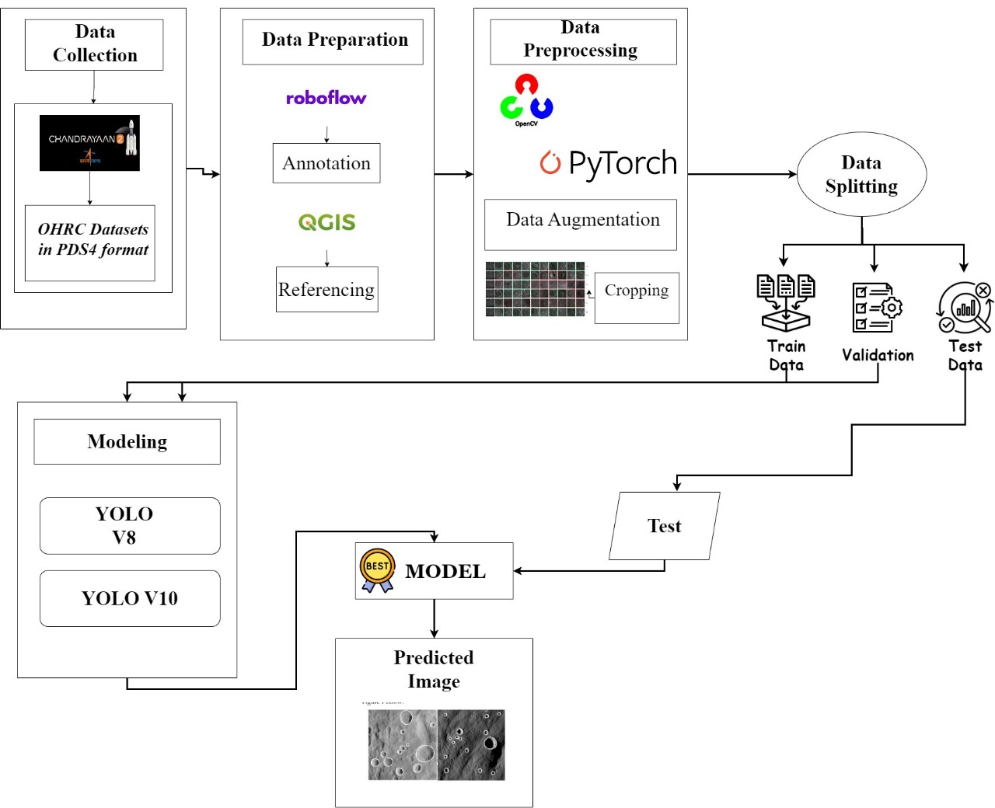
Proposed architecture/user diagram

Slide 6
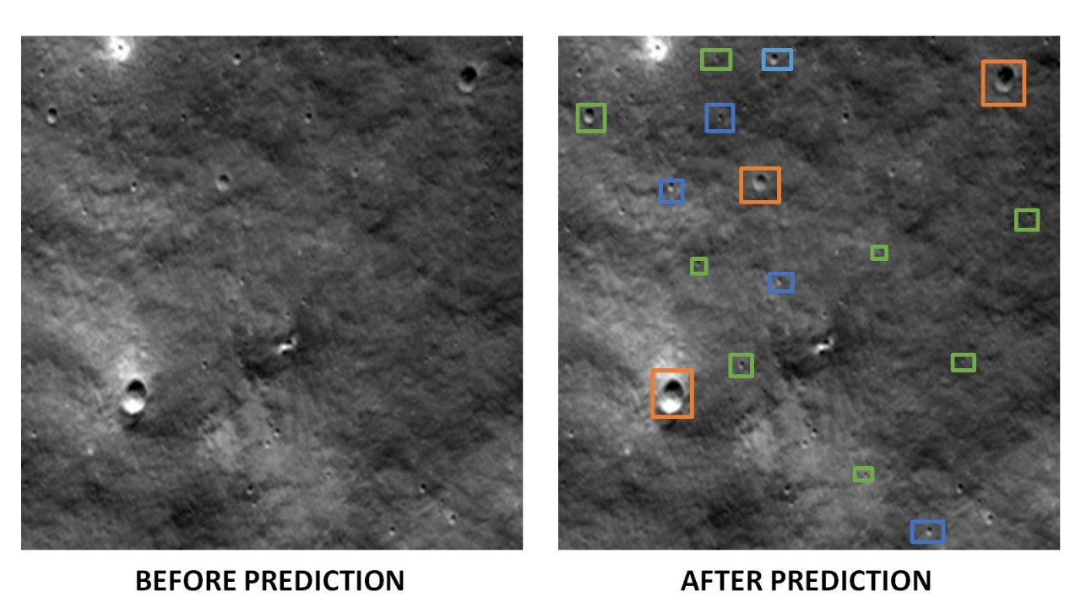
List of features offered by the solution
Strong transferability and generalization abilities of the DL model will enable its successful application in the detection of tiny, medium, and big craters on the Moon's celestial body.

Slide 7
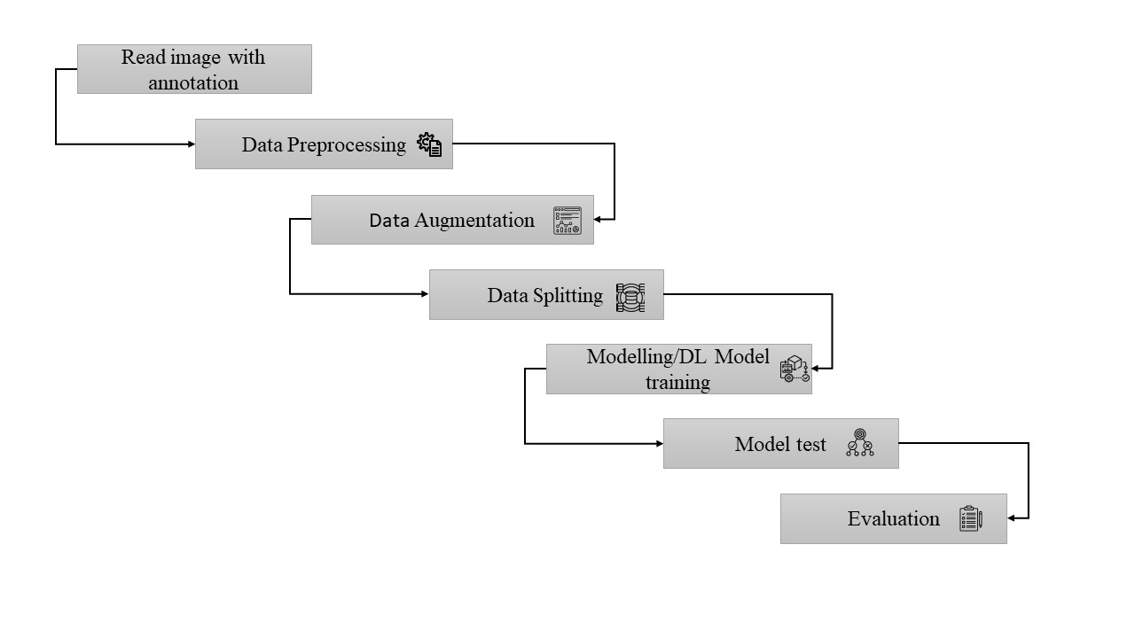
Process flow diagram or Use-case diagram

Slide 8
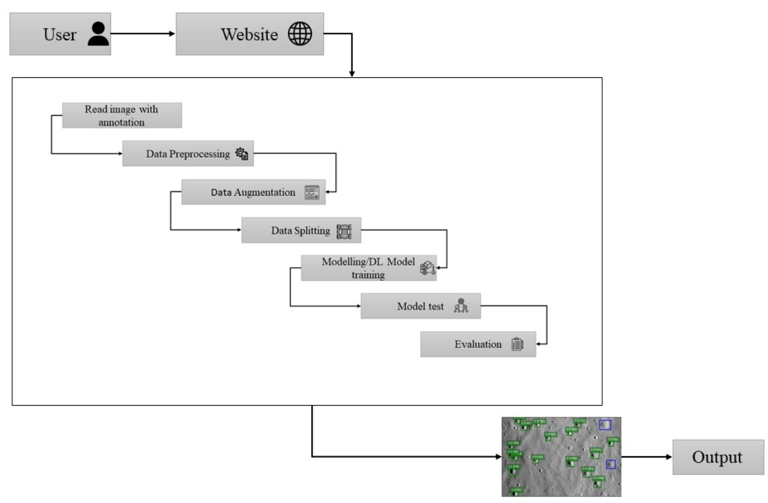
Wireframes/Mock diagrams of the proposed solution

Slide 9
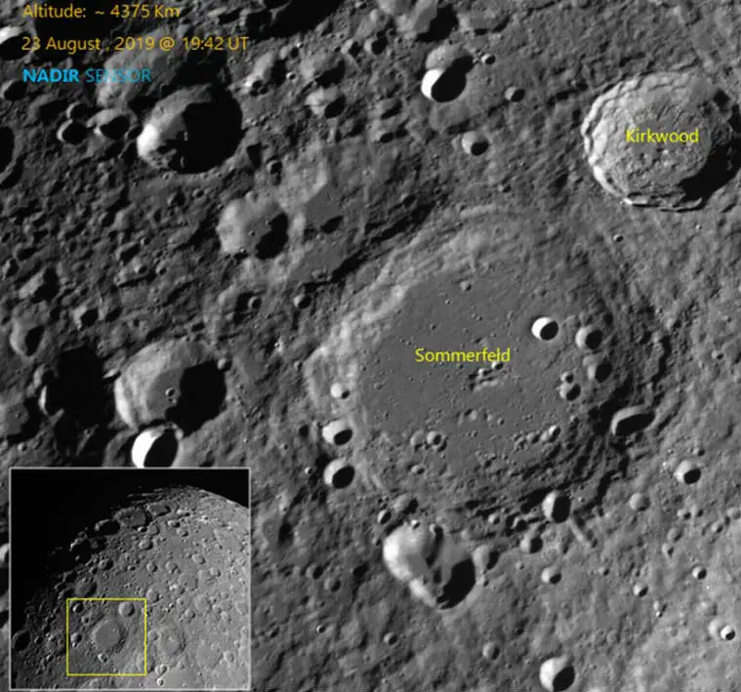
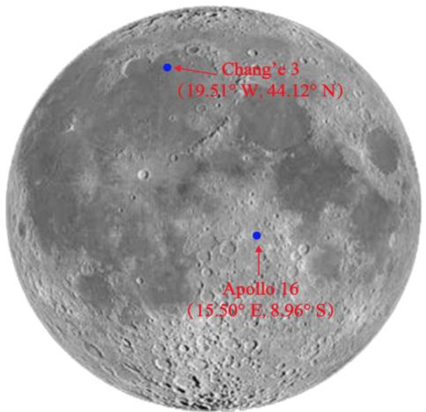
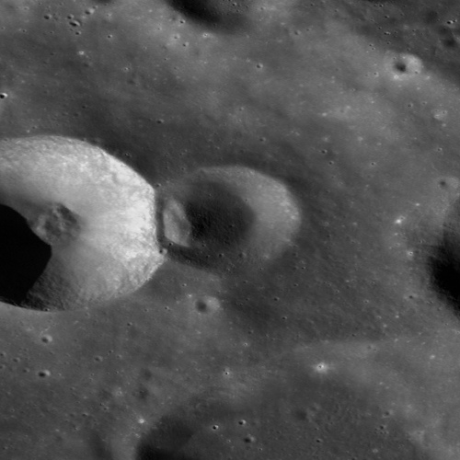
Solution Brief (Overall)
Data Source:
Tools Used:
High-resolution OHRC images from the Chandrayaan-2 mission.
Roboflow for annotation and segmentation.
QGIS for georeferencing.
Open-CV for image-processing
Objective:
Workflow:
Detect and analyze craters on the lunar surface using deep learning techniques.
Classify them as small, medium and large according to their diameters.
Select areas of interest (AOI).
Annotate features.
Train models for accurate predictions.

Slide 10
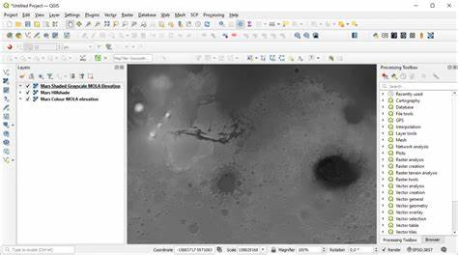
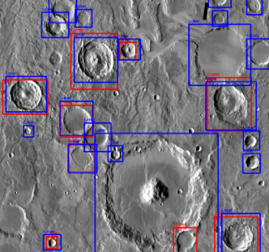
Comparison
Previous Work: These methods primarily addressed detecting the craters using DL strategies, which lacked the ability to classify the various craters on the surface of the Moon.
Advantage: Unlike the previous work, which lacks in classifying the sizes according to its diameters this model classifies the craters as small, medium and large.

Slide 11
